Slide 1
4-day school week
Parent Survey Results
4-day school week Committee Meeting One
November 2, 2022

Slide 2
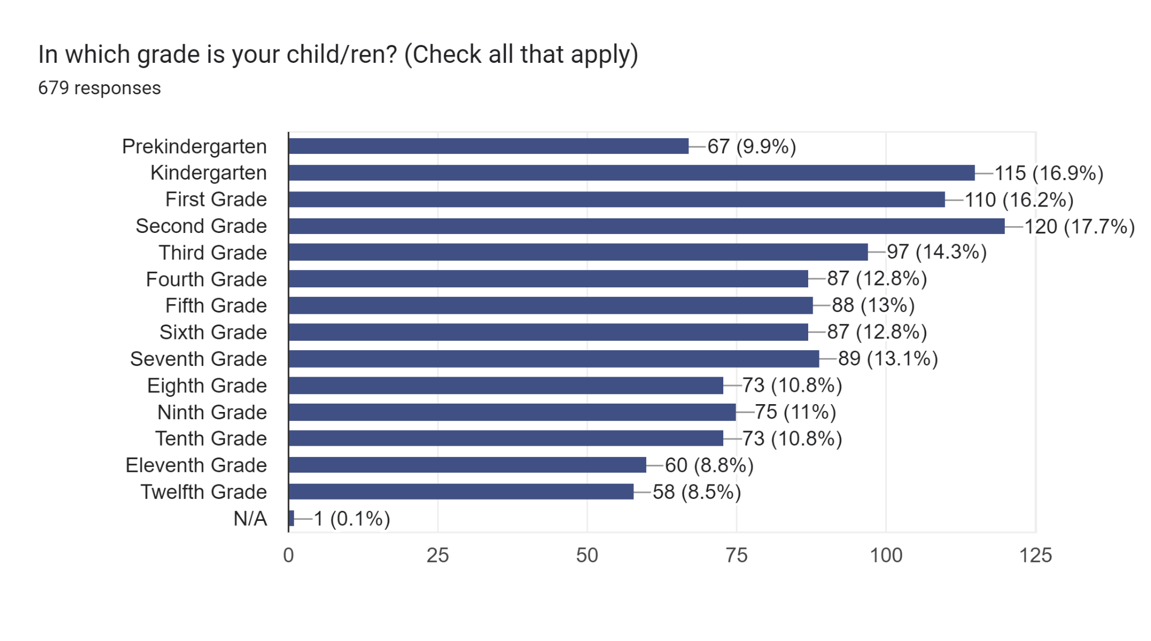

Slide 3
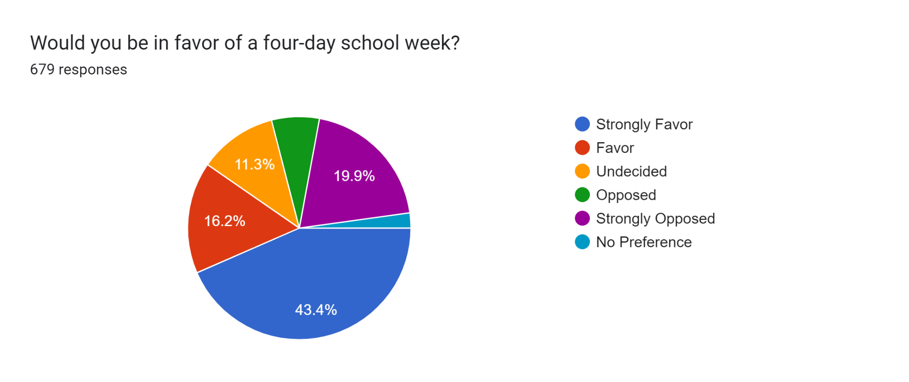

Slide 4
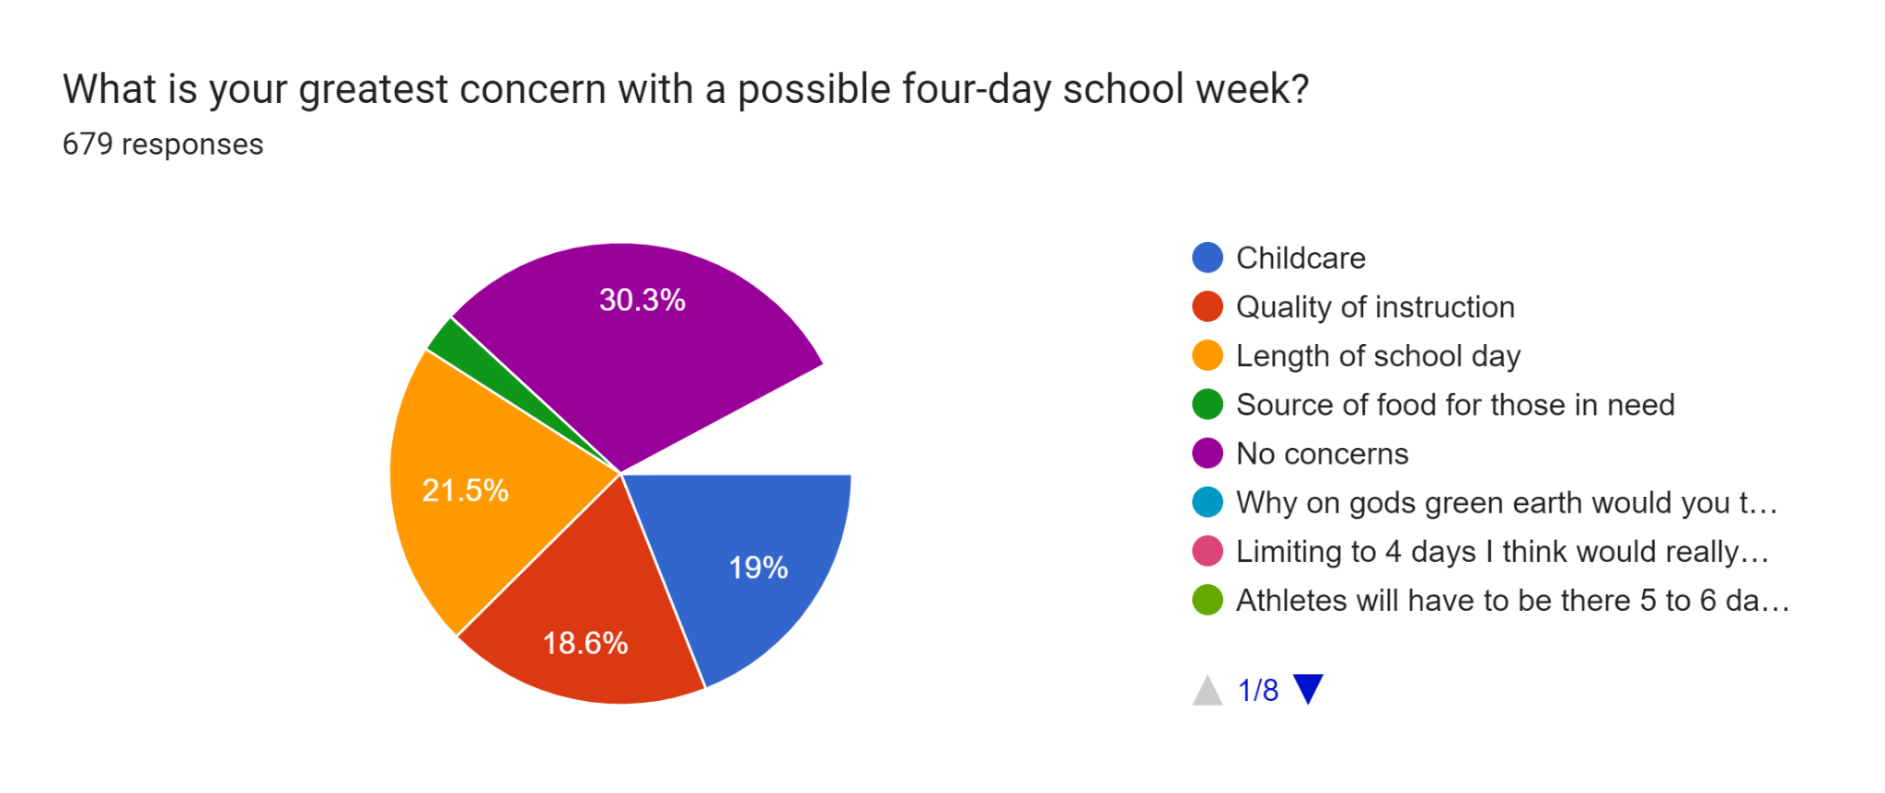
Notes:
Childcare
Quality of instruction
Length of school day

Slide 5
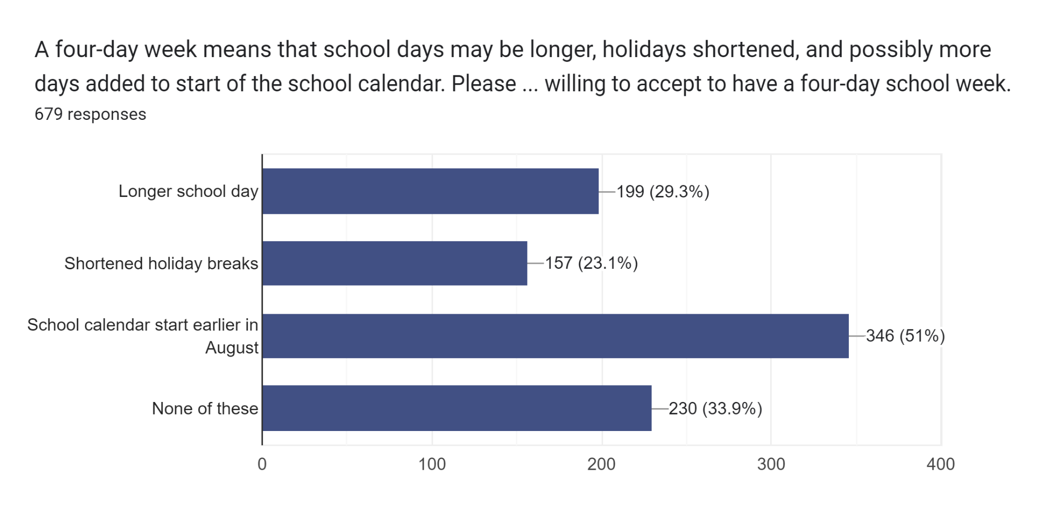

Slide 6
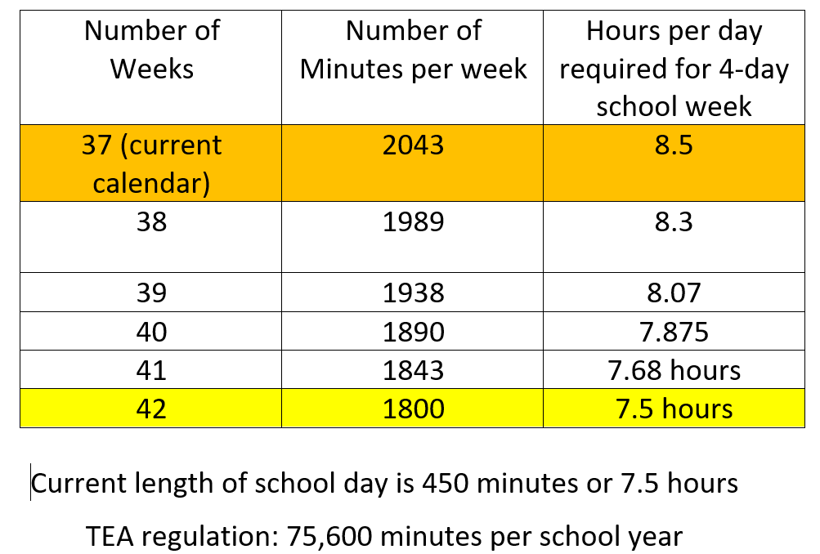
Scenarios - Lengthen school day or school year
Ed Week Article
Ed Week Article

